Slide 1
Compulsory English (BA-FY)- “Search for a Stranger” by Gordon S Livingston
Dr. Nirmala S. Padmavat
Director, IQAC
Nutan Mahavidyalaya, Selu

Slide 2
The story “Search for a Stranger” by Gordon S Livingston deals with the relationships that can exist between strangers. Many a time, people meet strangers and later they realize that they are very close to them. It is actually the story of the author’s search for his own mother. He feels that his mother is a stranger since he was adopted and did not know the truth of dual identity until he was 38 years old.

Slide 3
The author of the story “Search for a Stranger” was a child psychiatrist who worked in Columbia, USA. One day his cousin asked him about his work. The author told him about a conference on adopted children which he had attended. In the conference, the complicated circumstances faced by the adopted children were discussed and debated. It was concluded that the adopted children require professional assistance to overcome emotional problems they confront. One of the emotional problems identified was the feeling of the double identity.

Slide 4
If a child feels to make out about his/her natural parents, the law does not lend a hand to him / her. The courts usually seal the adoption records. However, an adopted child usually feels horrific when he/she cannot find out about his/her birth. He/she feels that there is something disgraceful about his/her birth and so his /her birth has been kept a secret.

Slide 5
The cousin questioned why he adopted children required knowing about his / her adoption. The author reasoned that the child should know the truth from the adoptive parents because if he/she comes to know the truth about his/her adoption from other people, there can be severe psychological harm. The author’s fourth child, Michael was adopted and he had been told the truth.

Slide 6
The cousin then asked what he would do if he came to know that he was an adopted child. The author replied that he would start searching for his natural parents. The cousin just then asked him to start searching for his parents. First, the author thought that his cousin was joking but when he realized that he was speaking the truth, he (the author) felt very bad.

Slide 7
The author come to know the truth when he as 38 years old. He was very upset as till then he thought his adopted parents were his natural parents. He had been thinking that he was a Scotch-Irish. Many questions stirred his mind. He was suddenly experiencing the problems that an adopted child experiences when he / she finds the truth. He asked his adopted father why he had hidden the truth from him.

Slide 8
He said he was afraid that he (the author) might have liked to see his natural parents. His adopted parents were afraid of losing him. The author assured his adopted father that he would always consider him and mother as his parents. His mother who adopted the author had died a year ago. The author then started for his natural parents.

Slide 9
The author was born on June 30, 1938. When he was adopted, his parents had been living in the city of Detroit. He was adopted from an agency in Memphis, Tennessee. Therefore, the author telephoned the Martins and instituted that he had been adopted from the Tennessee Children’s Home Society. The author required permission from the Tennessee Department of Public Welfare to check the records of the children’s home society. But, since all adoption records were sealed by law, permission was not granted.

Slide 10
Gordon left his adoptive father on his permission and flew to Memphis to find the record in the Memphis city hall (every American town has a library and reading hall). He then rushed to a local newspaper office and asked for its old issues. The front-page story of a newspaper revealed that the director had been selling children for high fees and making money. She told the babies of unwed mother, prostitutes and mental patients. So the Home had been closed.

Slide 11
The author wondered to which category he belonged to. He engaged to a local lawyer to help him in his search. The next day the lawyer found out that the author’s birth name was Donald Alfred Cardell. His sealed records were in the Memphis courthouse. The next morning, the author and his lawyer went to the courthouse and requested to see the records. The records were given to him.

Slide 12
His adoption decree was signed on August 17, 1940. His mother’s name was Ann Simmons Cardell. The records stated that the father had abandoned the child. The author asked for a copy. The clerk realized the author was holding his adoption decree. She took the adoption decree from him and said that he had to get the permission of the judge for a copy. The author’s lawyer brought forth that his mother had been a school teacher from Mississippi.

Slide 13
The author flew to Jackson, the capital of Mississippi and found his mother’s name in the academic records of the Department of Education. She had completed her master’s degree in education in the year 1952. The author made a phone call to the college’s alumni office. They informed him that they had received a letter from Miss Cardell ten years ago from a place called Netchez. He found the name of Alfred Cardell Jr in the phone book. He made a phone call to Alfred and found that Ann Cardell was his aunt. He told the author that Ann Cardell was living in Savannah.

Slide 14
The author flew to Savannah and called up Ann Cardell. He told her that he was her son and that he would like to meet her. She invited him to her home. Ann Cardell, his mother, was an elderly dignified lady above sixty years of age. She served him coffee. She then began to narrate the author about his birth. She was born in a farming family in Mississippi.

Slide 15
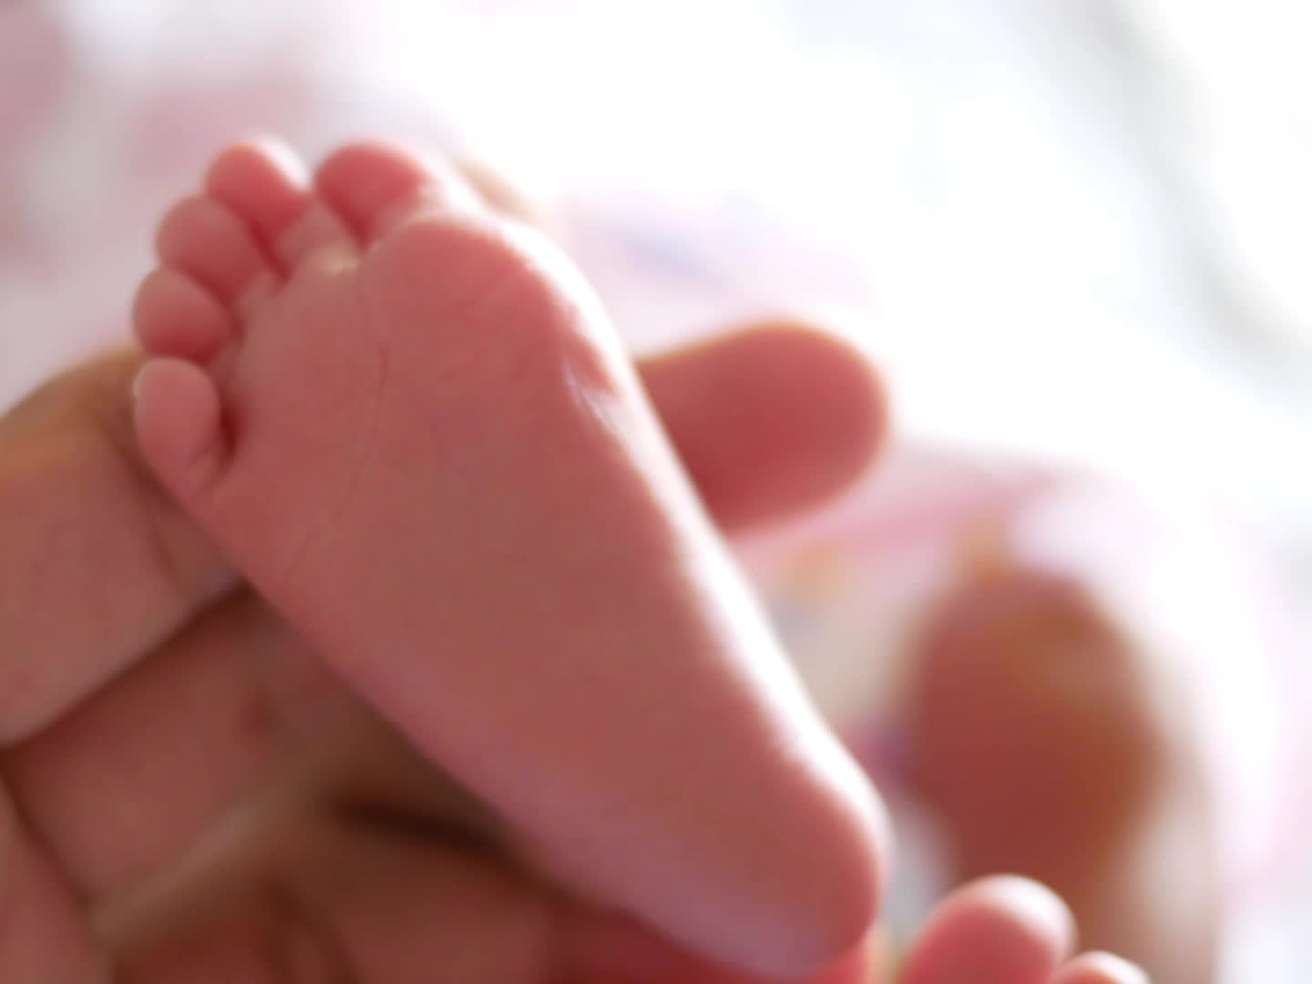
She had fallen in love with a handsome man, who was a marvelous dancer of twenty-eight years old. When she was pregnant, she had begged him to marry her. But he was never seen again. Ann unmarried pregnant lady was not respected. So, she went to Memphis to have the baby. In this manner, she told, the author was born and no one knew about it.

Slide 16
The author felt, he was listening to his life history. He sympathized with his mother. His father had died of cancer three years ago. His mother also told him how she kept in touch with him. She had a unique way of keeping track of him through her students.

Slide 17
She would assume her students to be her son. When she comforted a child, she felt as if she were comforting her own child, the author. When she knew that the author would be in the third grade she applied for a transfer to that grade.

Slide 18
By doing this, she felt that she was close to her son. But then, she felt that she was becoming selfish. She wanted to see him as a man. She was proud that he was now sitting in front of her. She asked for forgiveness. She held out her arms. The author touched his mother for the first time in the last thirty-eight years.

Slide 19
Conclusion
Thus, the author of the story unfolded the secret of an adopted child’s life. This is a breath-taking and traumatic record of real-life experience of an orphan.

Slide 20
Thank you!

